Slide 1
Student Class Recommendation Algorithm
Virdeep Singh, ft. Emaddeen Amm and Juliana Sanchez

Slide 2
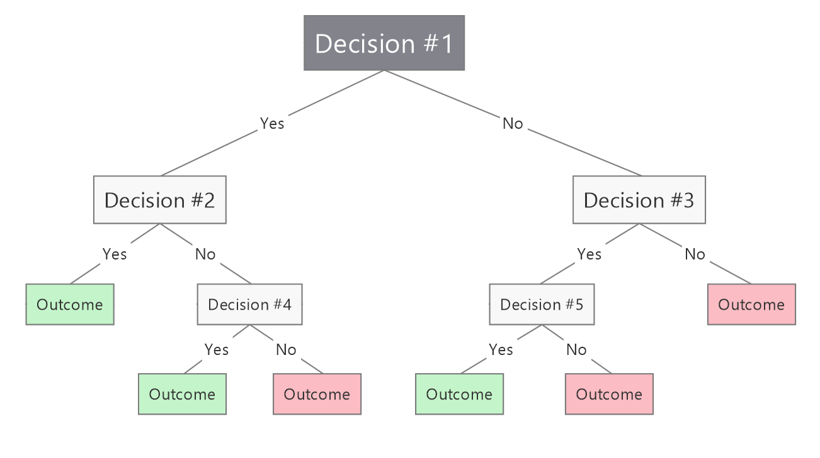
Designed for Students
It would be a great feature within Student Planning or any other Widener tool for students to get recommended classes automatically based on several factors
Made in Python with
  Directed Acyclic Graph (DAG): a graph data structure for pre-req organization
  ML algorithm (Decision Tree) --->

Slide 3
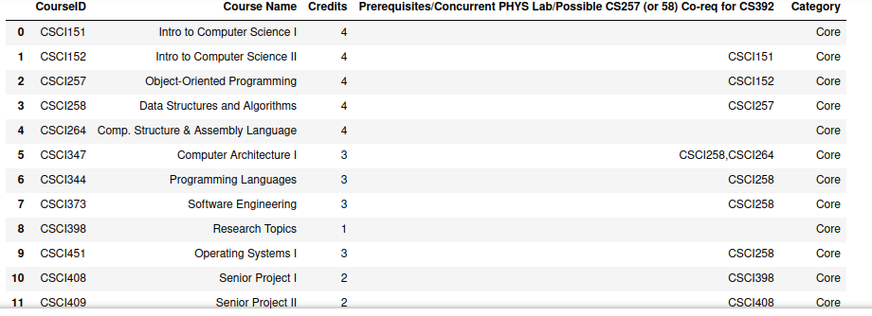
Sample of My Dataset
For now, designed only for CS majors for simplicity purposes (required and elective classes that CS students take or can take)
Popularity Score, Semester Offered, Typical Year Recommended, Course Depth (total pre-reqs/ measures the amount of pre-req layers a course has) will be the newly added columns (features) for the ML tree aspect

Slide 4
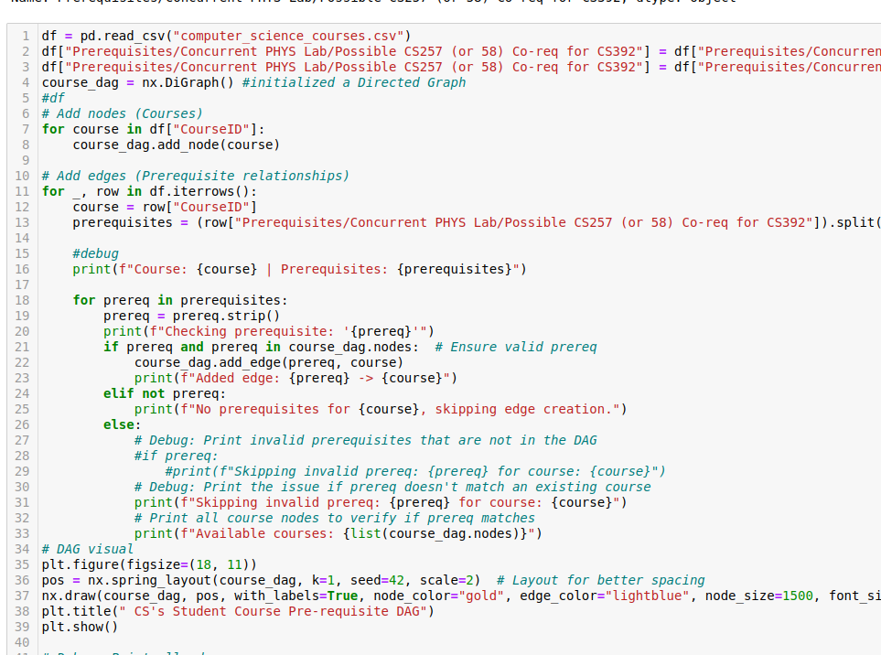
Code for the DAG

